Slide 1
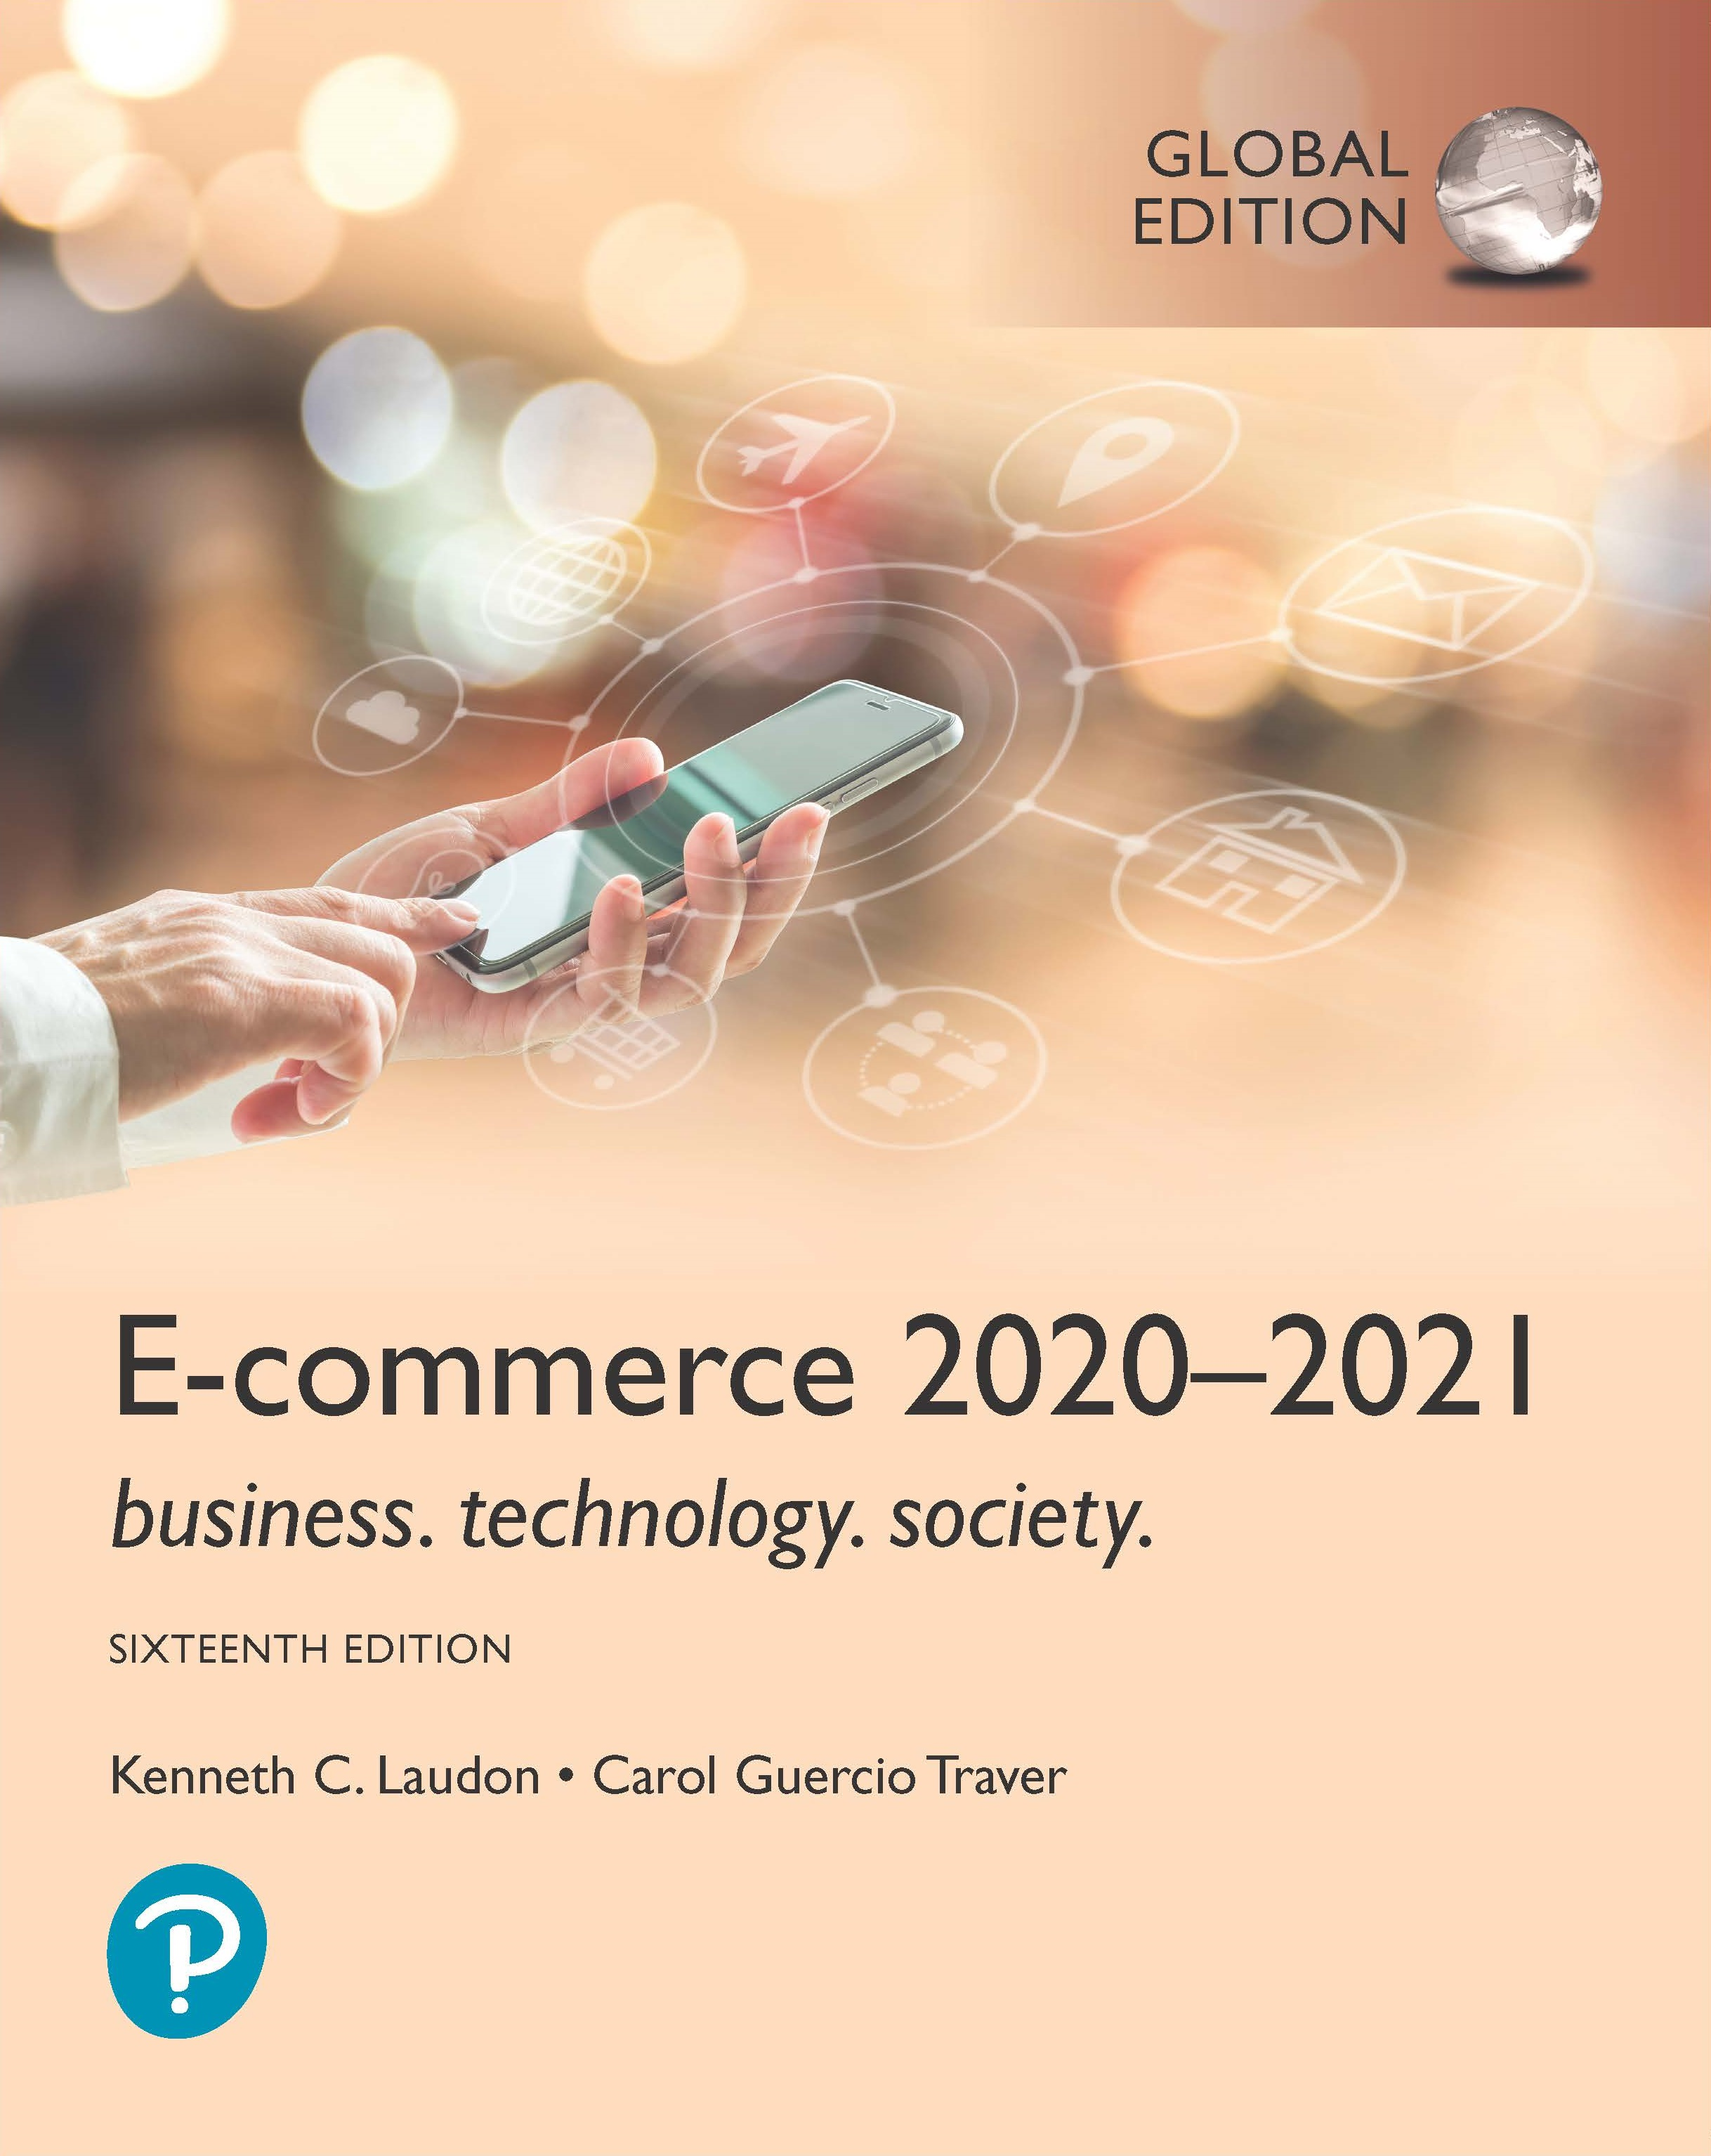
E-commerce 2020-2021: Business. Technology. Society.
Sixteenth Edition, Global Edition
Chapter 3
Building an E-commerce Presence
Copyright © 2021 Pearson Education Ltd. All Rights Reserved
Notes:
If this PowerPoint presentation contains mathematical equations, you may need to check that your computer has the following installed:
1) MathType Plugin
2) Math Player (free versions available)
3) NVDA Reader (free versions available)

Slide 2
Learning Objectives
3.1 Understand the questions you must ask and answer, and the steps you should take, in developing an e-commerce presence.
3.2 Explain the process that should be followed in building an e-commerce presence.
3.3 Identify and understand the major considerations involved in choosing web server and e-commerce merchant server software.
3.4 Understand the issues involved in choosing the most appropriate hardware for an e-commerce site.
3.5 Identify additional tools that can improve website performance.
3.6 Understand the important considerations involved in developing a mobile website and building mobile applications.
Notes:
Slide 2 is list of textbook LO numbers and statements

Slide 3
Scratch Builds an E-commerce Presence
Class Discussion
What were Scratch's e-commerce objectives?
What were the conditions that made it an ideal opportunity for Scratch to establish an e-commerce presence?
How has Scratch adapted the way it works to cater to the demands of an online customer base?

Slide 4
Imagine Your E-commerce Presence (1 of 3)
Before you begin to build a website or app of your own, there are some important questions you need to think about the answer.
What’s the idea? The vision includes:
Mission statement
Target audience
Intended market space
Strategic analysis
Marketing matrix
Development timeline
Preliminary budget

Slide 5
Imagine Your E-commerce Presence (2 of 3)
Where’s the money?
Business model(s)
Revenue model(s)
Who and where is the target audience?
Demographics, lifestyle, consumption patterns, etc.
What is the ballpark? Characterize the marketplace
Size, growth, demographics, structure
Notes:
Business models: Portal, e-tailer, content provider, transaction broker, market creator, service provider and community provider (social networks)
Revenue models: Advertising, subscriptions, transaction fees, sales, and affiliate revenue.
Affiliate marketing is an advertising model in which a company compensates third-party publishers to generate traffic or leads to the company’s products and services. The third-party publishers are affiliates, and the commission fee incentivizes them to find ways to promote the company.
Ballpark=estimate

Slide 6
Imagine Your E-commerce Presence (3 of 3)
Where’s the content coming from?
Know yourself-S W O T analysis
Develop an e-commerce presence map
Develop a timeline: Milestones
How much will this cost?
Simple website: up to $5000
Small startup: $25,000 to $50,000
Large corporate website: $100,000+ to millions

Slide 7
Figure 3.1 S W O T Analysis

Slide 8
Figure 3.2 E-commerce Presence Map
Notes:
Figure 3.2, Page 194.
An e-commerce presence requires firms to consider the three different kinds of presence, and the platforms and activities associated with each type of presence.
Full description: A diagram maps the activity and platform associated with each type of presence. There are four types of presence and each has a platform and activity. The first type of presence, Website or App, uses a traditional (desktop), mobile, and tablet platform. Activities include search, display, affiliates, and sponsorships. The second type of presence, social media, uses Facebook, Twitter, Pinterest, Instagram, and Blogs as a platform. Activities include conversation, engagement, sharing, and advice. The third type of presence, e-mail, uses internal lists and purchased lists as a platform. Activities include newsletters, updates, and sales. The fourth type of presence, offline media, uses print, T V, and radio as a platform. Activities include education, exposure, and branding.

Slide 9
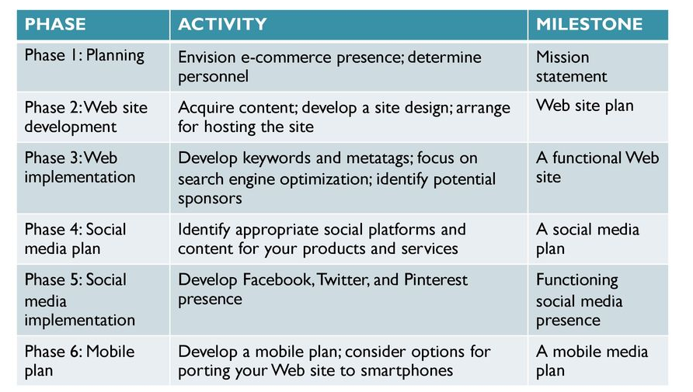
Figure 3.3 E-commerce Presence Timeline
Notes:
Figure 3.2, Page 194.
An e-commerce presence requires firms to consider the four different kinds of presence, and the platforms and activities associated with each type of presence.
Full description: A diagram maps the activity and platform associated with each type of presence. There are four types of presence and each has a platform and activity. The first type of presence, Website or App, uses a traditional (desktop), mobile, and tablet platform. Activities include search, display, affiliates, and sponsorships. The second type of presence, social media, uses Facebook, Twitter, Pinterest, Instagram, and Blogs as a platform. Activities include conversation, engagement, sharing, and advice. The third type of presence, e-mail, uses internal lists and purchased lists as a platform. Activities include newsletters, updates, and sales. The fourth type of presence, offline media, uses print, T V, and radio as a platform. Activities include education, exposure, and branding.

Slide 10
Building an E-commerce Site: A Systematic Approach
Most important management challenges:
Developing a clear understanding of business objectives
Knowing how to choose the right technology to achieve those objectives
Main factors to consider
Management
Hardware architecture
Software
Design
Telecommunications
Human resources

Slide 11
Planning: The Systems Development Life Cycle
Methodology for understanding business objectives of a system and designing an appropriate solution
Five major steps:
Systems analysis/planning
Systems design
Building the system
Testing
Implementation

Slide 12
Figure 3.5 Systems Development Life Cycle
Notes:
Figure 3.5, Page 198.
Full description. A flow diagram shows the systems development life cycle. The loop follows the following route. Systems Analysis and Planning, leading to Systems Design, leading to Building the System, leading to Testing, and finally leading to Implementation Service Delivery. After this step, the process again loops back to the Systems Analysis and Planning stage.
Best practices listed below are Continuous availability 99 percent plus, Design for scalability, Build in management for end-to-end delivery, Plan for growth, Design pages for high-speed performance, Understand and optimize workload on system.

Slide 13
System Analysis/Planning
Business objectives:
List of capabilities you want your site to have
System functionalities:
List of information system capabilities needed to achieve business objectives
Information requirements:
Information elements that system must produce in order to achieve business objectives

Slide 14
Table 3.2 System Analysis, Business Objectives, System Functionalities, and Information Requirements for a Typical E-commerce Site (1 of 2)
Business Objective | System Functionality | Information Requirements
Display goods | Digital Catalog | Dynamic text and graphics catalog
Provide product information | Product database | Product description, stocking numbers, inventory levels
Personalize/customize product | Customer on-site tracking | Site log for every customer visit; data mining capability to identify common customer paths and appropriate responses
Engage customers in conversations | On-site blog; user forums | Software with blogging and community forum functionality
Execute a transaction | Shopping cart/payment system | Secure credit card clearing; multiple payment options
Accumulate customer information | Customer database | Name, address, phone, and e-mail for all customers; online customer registration

Slide 15
Table 3.2 System Analysis, Business Objectives, System Functionalities, and Information Requirements for a Typical E-commerce Site (2 of 2)
Business Objective | System Functionality | Information Requirements
Provide after-sale customer support | Sales database | Customer I D, product, date, payment, shipment date
Coordinate marketing/advertising | Ad server, e-mail server, e-mail, campaign manager, ad banner manager | Site behavior log of prospects and customers linked to e-mail and banner ad campaigns
Understand marketing effectiveness | Site tracking and reporting system | Number of unique visitors, pages visited, products purchased, identified by marketing campaign
Provide production and supplier links | Inventory management system | Product and inventory levels, supplier I D and contact, order quantity data by product

Slide 16
Systems Design: Hardware and Software Platforms
System design specification:
Description of main components of a system and their relationship to one another
Two components of system design:
Logical design
Data flow diagrams, processing functions, databases
Physical design
Specifies actual physical, software components, models, and so on

Slide 17
Figure 3.6(a) A Logical Design for a Simple Website
Notes:
Figure 3.6(a), Page 201.
This data flow diagram describes the flow of information requests and responses for a simple website.
Full description: A simple data flow diagram depicts the logical design for a simple website. The data flow diagram connects various processes in a loop. These processes are: 1. A website customer sends an H T T P request to verify login. 2. The verify login process first retrieves customer information from the customer database and then either accepts or rejects the visitor. 3. If the visitor is accepted, catalog pages are displayed by connecting to a catalog database. 4. The display catalog pages process leads to the next process, which is purchase products. This stage is connected to a customer database, catalog database, and order database. 5. Once the order is placed, the next process is to fulfill the order, leading to the ship products stage. 6. When the order shipped, the ship products process again connects to website customer to confirm the process.

Slide 18
Figure 3.6(b) Physical Design for a Simple Website
Notes:
Figure 3.6(b), Page 201.
A physical design describes the hardware and software needed to realize the logical design.
Full description: A simple data flow chart that depicts the physical design for a simple website. The overall description of this simple physical design is: In a multi-tier architecture, a web server is linked to a middle-tier layer that typically includes a series of application servers that perform specific tasks, as well as to a backend layer of existing corporate systems.
The image of the simple physical design shows the following: 1. Customer connects from a mobile phone, smartphone, or desktop to Internet through a cable, D S L, T 1, satellite, cellular, or Wi-Fi. 2. Your firm’s website connects to the Internet through cable or F I O S. 3. At your firm’s end, hardware needed are H P or Dell web servers and 5 terabytes of storage. 4. Software needed are Oracle S Q L database, I B M WebSphere e-commerce suite, ad server, online catalog, mail server, and shopping cart.

Slide 19
Building the System: In-House Versus Outsourcing
Outsourcing: Hiring vendors to provide services involved in building site
Build own versus. outsourcing:
Build your own requires team with diverse skill set; choice of software tools; both risks and possible benefits
Host own versus. outsourcing
Hosting: Hosting company responsible for ensuring site is accessible 24/7, for monthly fee
Co-location: Firm purchases or leases web server (with control over its operation), but server is located at vendor’s facility

Slide 20
Figure 3.7 Choices in Building and Hosting
Notes:
Figure 3.7, Page 202.
You have a number of alternatives to consider when building and hosting an e-commerce site.
Full description: A matrix shows the various possible combinations in building and hosting the site. The four possible combinations are as follows. 1. When both the building and hosting are done in-house, the responsibility is completely in-house. 2. When the building is done in-house and the hosting is outsourced, there is mixed responsibility. 3. When the building is outsourced and the hosting is done in-house, there is mixed responsibility. 4. When both the building and hosting are outsourced, the product is completely outsourced.

Slide 21
Insight on Business: OVH Takes E-commerce to the Clouds
Class Discussion
What value does OVH offer to small businesses?
Are there any drawbacks to using OVH to create an e-commerce presence?
How are service providers like OVH changing the nature of e-commerce?

Slide 22
Testing the System
Testing
Unit testing
System testing
Acceptance testing
A/B testing (split testing)
Multivariate testing
Notes:
A/B testing(split testing) - involves showing two versions of a web page or website to different users to see which one performs better.
Multivariate testing – involves identifying specific elements(headlines, image, button, text), creating versions for each element and then creating a unique combination of each element and version test.

Slide 23
Implementation, Maintenance, and Optimization
Systems break down unpredictably
Maintenance is ongoing
Maintenance costs: Similar to development costs
A $40K e-commerce site may require $40K annually to upkeep
Benchmarking
Notes:
Benchmarking – a process in which the site is compared with those of competitors in terms of response speed, quality of layout, and design.

Slide 24
Figure 3.10 Factors in Website Optimization
Notes:
Figure 3.10, Page 209.
Website optimization requires that you consider three factors: page content, page generation, and page delivery.
Full description: An image depicts factors in optimizing website performance. There are three factors in website optimization along with the following items pertaining to each factor. First, Page Delivery, which includes Content delivery networks, Edge caching, and Bandwidth. Second, Page Generation, which includes Server response time, Device-based accelerators, Efficient resource allocation, Resource utilization thresholds, and Monitoring site performance. The third factor, Page Content, includes Optimize H T M L, Optimize images, Site architecture, and Efficient page style.

Slide 25
Alternative Web Development Methodologies
Prototyping
Agile development
DevOps
Component-based development
Web services
Notes:
Prototyping- consists of building a sample or model rapidly and inexpensively to test a concept or a process
Agile development – breaks down a large project into a series of smaller subprojects that are completed in short periods of time using iteration and continuous feedback.
Scrum – type of agile development that provides a framework for managing the development process
DevOps – build on agile development principles as an organizational strategy to create a culture and environment that further promote rapid and agile development process
Component-based development – enables a system to be built by assembling and integrating various software components that already have been assembled and which provide common functions
Web services – loosely coupled, reusable software components (with universal set of standards) using XML and other open protocols and standards that enable one application to communicate with another with no custom programming required to share data and services

Slide 26
Simple versus Multi-Tiered Website Architecture
System architecture
Arrangement of software, machinery, and tasks in an information system needed to achieve a specific functionality
Two-tier
Web server and database server
Multi-tier
Web application servers
Backend, legacy databases

Slide 27
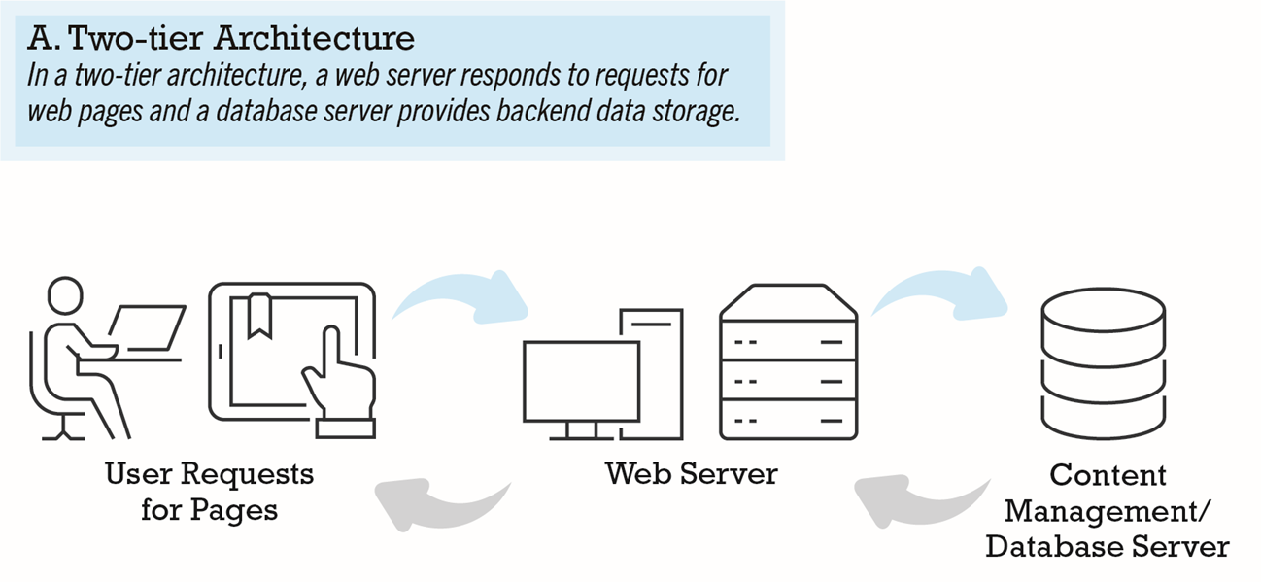
Figure 3.11(a) Two-Tier E-commerce Site Architecture
Notes:
Figure 3.11(a), Page 212.
In a two-tier architecture, a web server responds to requests for web pages and a database server provides backend data storage.
Full description: An image illustrates two-tier architecture. The image shows a user, who sends requests for pages to a web server. The web server sends the request to a content management slash database server. The content management slash database server sends the requested pages back to the web server which then sends them back to the user.

Slide 28
Figure 3.11(b) Multi-Tier E-commerce Site Architecture
Notes:
Figure 3.11(b), Page 212.
In a multi-tier architecture, a web server is linked to a middle-tier layer that typically includes a series of application servers that perform specific tasks, as well as to a backend layer of existing corporate systems.
Full description: An image illustrates multi-tier architecture. In a multi-tier architecture, there are three layers. The Web Server Layer consists of Web Servers that receive incoming Internet requests. The Middle-tier Layer consists of E-commerce Servers, Application Servers, Database Servers, Ad Servers, and Mail Servers. The Backend Layer consists of Corporate Applications, Finance, Production M R P, Enterprise Systems, and H R Systems. The incoming Internet request are sent by Web Servers to the Middle-tier Layer, from the Middle-tier Layer to the Backend Layer, from the Backend Layer back to the Middle-tier Layer, and from the Middle-tier Layer back to the Web Server Layer.

Slide 29
Web Server Software
Apache
Leading web server software
Works with U N I X, Linux operating systems
Reliable, stable, part of open software community
Microsoft’s Internet Information Server (I I S)
Second major web server software
Windows-based
Integrated, easy-to-use

Slide 30
Table 3.4 Basic Functionality Provided by Web Servers
Functionality | Description
Processing of H T T P requests | Receive and respond to client requests for H T M L pages
Security services (Secure Sockets Layer)/ Transport Layer Security | Verify username and password; process certificates and private/public key information required for credit card processing and other secure information
File Transfer Protocol | Permits transfer of very large files from server to server
Search engine | Indexing of site content; keyword search capability
Data capture | Log file of all visits, time, duration, and referral source
E-mail | Ability to send, receive, and store e-mail messages
Site management tools | Calculate and display key site statistics, such as unique visitors, page requests, and origin of requests; check links on pages

Slide 31
Site Management Tools
Basic tools included in all web servers
Verify that links on pages are still valid
Identify orphan files
Third-party software for advanced management
Monitor customer purchases
Marketing campaign effectiveness
Keep track of hit counts and other statistics
Example: Webtrends Analytics 10
Notes:
Webtrends is a site management tool

Slide 32
Dynamic Page Generation Tools
Dynamic page generation:
Contents stored in database and fetched when needed
Common tools:
C G I, A S P, J S P, O D B C, J D B C
Advantages
Lowers menu costs
Permits easy online market segmentation
Enables cost-free price discrimination
Enables content management system (C M S)

Slide 33
Application Servers
Web application servers:
Provide specific business functionality required for a website
Type of middleware
Isolate business applications from Web servers and databases
Single-function applications being replaced by integrated software tools that combine all functionality needed for e-commerce site

Slide 34
E-commerce Merchant Server Software
Provides basic functionality for sales
Online catalog
List of products available on website
Shopping cart
Allows shoppers to set aside, review, edit selections, and then make purchase
Credit card processing
Typically works in conjunction with shopping cart
Verifies card and puts through credit to company’s account at checkout

Slide 35
Merchant Server Software Packages (1 of 3)
Integrated environment that includes most of functionality needed
Shopping cart
Merchandise display
Order management

Slide 36
Merchant Server Software Packages (2 of 3)
Different options for different-sized businesses
Small and medium-sized businesses: Yahoo Small Business; open-source solutions
Mid-range: I B M WebSphere Commerce Express; Sitecore Experience Commerce
High-end: I B M WebSphere Professional/Enterprise; S A P Hybris, Oracle A T G Web Commerce, etc.
Many now also available as cloud-based SaaS solutions.

Slide 37
Merchant Server Software Packages (3 of 3)
Key factors in selecting a package
Functionality
Support for different business models, including m-commerce
Business process modeling tools
Visual site management and reporting
Performance and scalability
Connectivity to existing business systems
Compliance with standards
Global and multicultural capability
Local sales tax and shipping rules

Slide 38
Choosing Hardware
Hardware platform:
Underlying computing equipment needed for e-commerce functionality
Objective:
Enough platform capacity to meet peak demand without wasting money
Important to understand the factors that affect speed, capacity, and scalability of a site

Slide 39
Right-Sizing Your Hardware Platform: the Demand Side
Customer demand:
Most important factor affecting speed of site
Factors in overall demand:
Number of simultaneous users in peak periods
Nature of customer requests (user profile)
Type of content (dynamic versus static Web pages)
Required security
Number of items in inventory
Number of page requests
Speed of legacy applications

Slide 40
Right-Sizing Your Hardware Platform: the Supply Side
Scalability:
Ability of site to increase in size as demand warrants
Ways to scale hardware:
Vertically
Increase processing power of individual components
Horizontally
Employ multiple computers to share workload
Improve processing architecture
Outsource hosting, use content delivery network

Slide 41
Table 3.8 Vertical and Horizontal Scaling Techniques
Technique | Application
Use a faster computer | Deploy edge servers, presentation servers, data servers, etc.
Create a cluster of computers | Use computers in parallel to balance loads.
Use appliance servers | Use special-purpose computers optimized for their task.
Segment workload | Segment incoming work to specialized computers.
Batch requests | Combine related requests for data into groups, process as group.
Manage connections | Reduce connections between processes and computers to a minimum.
Aggregate user data | Aggregate user data from legacy applications in single data pools.
Cache | Store frequently used data in cache rather than on the disk.

Slide 42
Table 3.9 Improving the Processing Architecture of Your Site
Architecture Improvement | Description
Separate static content from dynamic content | Use specialized servers for each type of workload.
Cache static content | Increase R A M to the gigabyte range and store static content in R A M.
Cache database lookup tables | Use cache tables used to look up database records.
Consolidate business logic on dedicated servers | Put shopping cart, credit card processing, and other C P U-intensive activity on dedicated servers.
Optimize A S P code | Examine your code to ensure it is operating efficiently.
Optimize the database schema | Examine your database search times and take steps to reduce access times.

Slide 43
Other E-commerce Site Tools
Website design: Basic business considerations
Enabling customers to find and buy what they need
Tools for search engine optimization
Search engine placement
Metatags, titles, content
Identify market niches
Offer expertise
Links
Buy ads
Local e-commerce

Slide 44
Table 3.10 E-commerce Website Features That Annoy Customers (1 of 2)
Feature
Requiring user to view ad or intro page before going to website content
Pop-up and pop-under ads and windows
Too many clicks to get to the content
Links that don’t work
Confusing navigation; no search function
Requirement to register and log in before viewing content or ordering
Slow loading pages
Content that is out of date

Slide 45
Table 3.10 E-commerce Website Features That Annoy Customers (2 of 2)
Inability to use browser’s Back button
No contact information available (web form only)
Unnecessary splash/flash screens, animation, etc.
Music or other audio that plays automatically
Unprofessional design elements
Text not easily legible due to size, color, format
Typographical errors
No or unclear returns policy

Slide 46
Table 3.11 The Eight Most Important Factors in Successful E-commerce Site Design
Factor | Description
Functionality | Pages that work, load quickly, and point the customer toward your product offerings
Informational | Links that customers can easily find to discover more about you and your products
Ease of use | Simple foolproof navigation
Redundant navigation | Alternative navigation to the same content
Ease of purchase | One or two clicks to purchase
Multi-browser functionality | Site works with the most popular browsers
Simple graphics | Avoids distracting, obnoxious graphics and sounds that the user cannot control
Legible text | Avoids backgrounds that distort text or make it illegible

Slide 47
Tools for Interactivity and Active Content
C G I (Common Gateway Interface)
A S P (Active Server Pages)/A S P.NET
Java, J S P, and JavaScript (including Angular J S, D3, jQuery and Ajax)
ActiveX and V B Script
ColdFusion
P H P, Ruby on Rails, Django
Other design elements:
Widgets, mashups
Notes:
Widget - a small, prebuilt chunk of code that executes automatically in your HTML web page; capable of performing a wide variety of tasks. Social networks and blogs use widgets to present users with content drawn from around the web, calendars, clocks, weather live TV, games etc.
Mashups – are a little more complicated and involve pulling functionality and data from one program and including it in another. The most common mashup involves using Google Maps data and software and combining it with other data. For instance, if you have a local real estate website, you can download Google Maps and satellite image applications to your site so visitors can get a sense of the neighborhood.

Slide 48
Personalization Tools
Personalization
Ability to treat people based on personal qualities and prior history with site
Customization
Ability to change the product to better fit the needs of the customer
Cookies
Primary method to achieve personalization

Slide 49
The Information Policy Set
Privacy policy
Set of public statements declaring how site will treat customers’ personal information that is gathered by site
Accessibility rules
Set of design objectives that ensure users with disabilities can effectively access site

Slide 50
Insight on Society: Designing for Accessibility
Class discussion:
Why might some merchants be reluctant to make their websites accessible to users with disabilities?
How can websites be made more accessible?
Should all websites be required by law to provide “equivalent alternatives” for visual and sound content?
What additional accessibility problems do mobile devices pose?

Slide 51
Developing a Mobile Website and Building Mobile Applications
Types of m-commerce software
Mobile website
Responsive Web design
Mobile Web app
Native app
Hybrid app
Runs inside native container
App distribution
Based on H T M L5, C S S, JavaScript

Slide 52
Planning and Building a Mobile Presence
Identify business objectives, system functionality, and information requirements
Choice:
Mobile website or mobile Web app
Less expensive
Native app
Can use device hardware, available offline

Slide 53
Table 3.13 Unique Features That Must be Taken into Account When Designing a Mobile Presence
Feature | Implications For Mobile Platform
Hardware | Mobile hardware is smaller, and there are more resource constraints in data storage and processing power.
Connectivity | The mobile platform is constrained by slower connection speeds than desktop websites.
Displays | Mobile displays are much smaller and require simplification. Some screens are not good in sunlight.
Interface | Touch-screen technology introduces new interaction routines different from the traditional mouse and keyboard. The mobile platform is not a good data entry tool but can be a good navigational tool.

Slide 54
Mobile Presence Design Considerations
Platform constraints
Graphics, file sizes
Mobile first design
Desktop website design after mobile design
Responsive web design (R W D)
C S S site adjusts layout of site according to device screen resolutions
Adaptive web design (A W D)
Server delivers different templates or versions of site optimized for device

Slide 55
Cross-Platform Mobile App Development Tools
Objective C, Java
Low cost, open-source alternatives
Appery.io
Codiqa
Swiftic
PhoneGap
Axway Appcelerator

Slide 56
Mobile Presence: Performance and Cost Considerations
Mobile first design
Most efficient
Mobile website
Resizing existing website for mobile access is least expensive
Mobile web app
Can utilize browser A P I
Native app
Most expensive; requires more programming

Slide 57
Insight on Technology: Klook Sets Its Sights on New Vistas
Class Discussion
What influenced Klook in deciding to create a mobile app?
Are there any disadvantages in making a mobile app a central part of the Klook experience?
How does connectivity integration add value to the cruising experience?

Slide 58
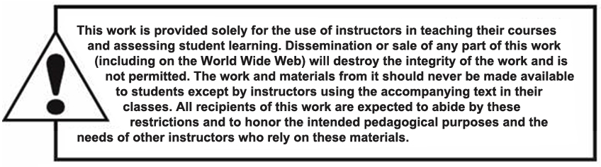
Copyright

